Slide 1

EngD in Non-Destructive Evaluation Ultrasonic Transduction Course Array Transducer Design Guidelines
Notes:
Hello!

Slide 2
The Plan – 1h lecture
Ultrasonic image quality
Construction of the phased array probe
Gathering signals with probe
Simulations, calculations
Near field and far field
Design guidelines
Example design
Time to play with cueBEAM

Slide 3
Ultrasonic image quality
What is an image
Benefits of ultrasound NDE
What is a good image?
Detection, characterisation: a function of sensitivity, contrast and resolution
All of the above is a function of price . . .
Notes:
“Image” in measurement sense, is a representation of certain measured physical quantities or qualities. For example, if we say that the inflation last year was 5%, this does not tell you how much more the your breakfast was, or how much more you paid for the bus ticket, but you do get an image of how much did the rich steal from the poor.
In the same way, we can probe a specimen with ultrasonic energy, gather signals, process them and obtain an “image” of the interior. It is important to note that the ultrasonic image is unlike optical image: one can mostly only see the reflections from reflectors inside; do not confuse visualization of these reflectors with the reflectors themselves.
Benefits of ultrasound for NDE compared to other methods are that mechanical vibrations can penetrate deep into the specimen, (not only surface); and also, that the reflections of ultrasound more often than not do correspond to what we want to see: mechanical discontinuities.
Good image – is one that tells you what you want to know, and does it cheap. 1D or 2D Ultrasonic phased arrays can often fill this role, but never forget that there are also single-element probes and other techniques. It is important to learn about capabilities and limitations of each technique to select appropriate one.
Good image quality begins with a good probe. Let’s see what can we see about the probe.

Slide 4
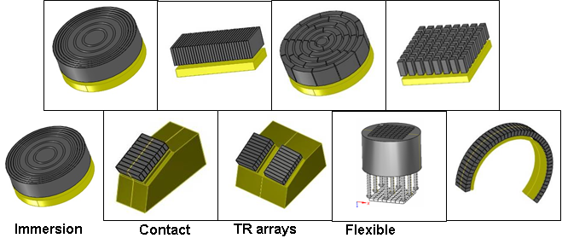
Phased array types
Annular
1D/linear
Sectorial
2D/matrix
Special

Slide 5
Linear Arrays
d
e
g
n = 12
W
A
Notes:
(demo) This is an phased array ultrasonic probe.
Fundamentally, it is built using a series of elements that are indyvidually electrically connected. These are it’s geometrical dimensions, that we are going to be talking about today:
W is the passive aperture
A is the active aperture
n is number of elements
d is the element pitch – distance between centres of elements
e is the element geometric width
g is the distance between element borders.
Engineering of these values is critical for obtaining good images. How can we know how to design them?

Slide 6
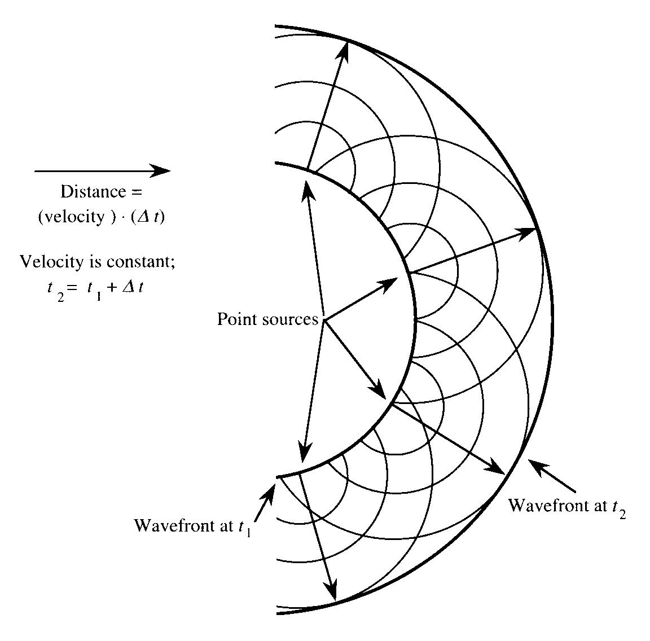
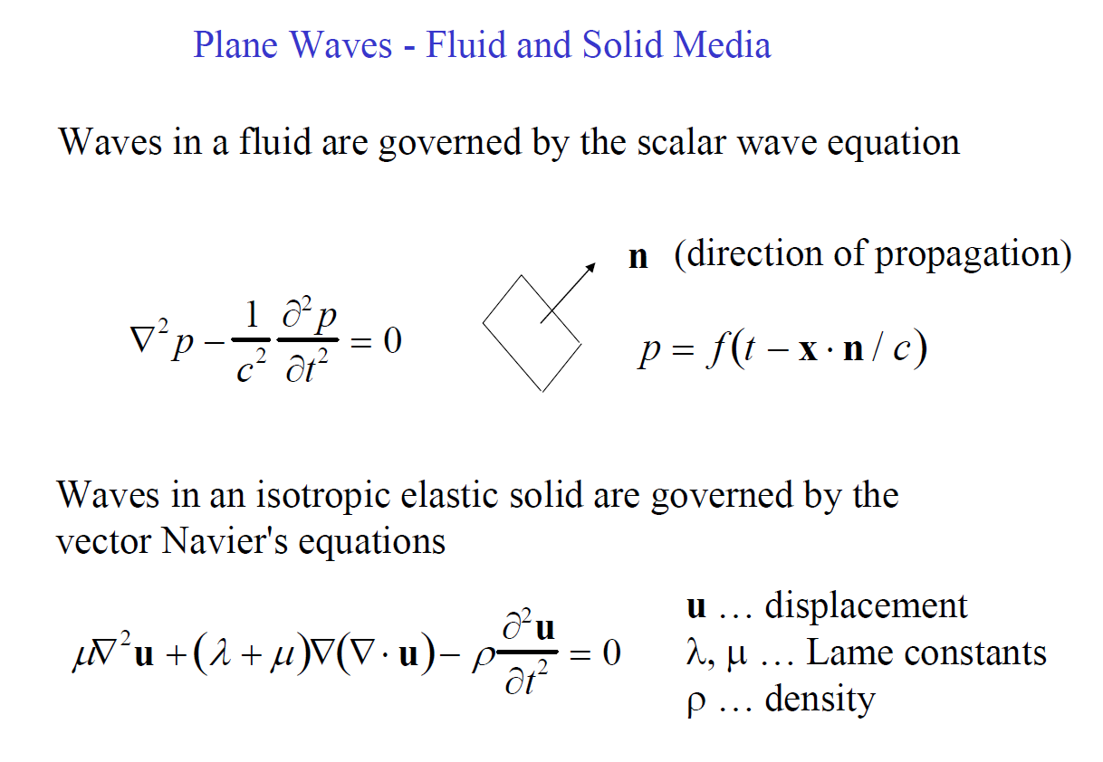
Acoustic beam simulation
Basic Newtonian physics:
F=m*a
And Hooke’s law
F=k*x
Rayleigh integral
x
m , k
F
Huygens principle
Wave equation
Liquids (acoustic waves)
Solids (elastic waves)
Source: The UniveRsal Library (URL)
Notes:
We have to use simulation of the acoustic field that is generated by these elements . . . .
It all begins with basic Newtonian physics. Note that a = acceleration – includes a time component. The mass *M* is an “elementary mass” that is in principle, very small, the same kind of small as in calculating a derivative from definition, using limits. Manipulation of these two equations lead us to wave equations. These equations are simpler for liquids; for solids, since there is two kinds of elasticity for the solid body (bulk and shear) – the equation is a bit more complicated.
But these basic equations are not very useful. General solution for these equations is intractible; there only exist solutions for specific cases, like eg. Planar wave, spherical wave, wave in strings, rods, plates etc. For our purposes, we are interested in bulk waves.
There exists a very useful geometrical construct allowing us to understand how waves propagate – Huygens principle. It is a little similar to Fourier transform. It states that any wavefront is simply a sum of spherical waves emanating from all points for which the vibration is known. This principle goes a good distance explaining most of the phenomena that we are interested in. Then, Rayleigh integral is again, a specific approach to solving the wave equation assuming that a defined area vibrates uniformly, and the area around it does not vibrate at all. This is useful for determining wavefronts emitted by a probe aperture.
Sources:
http://mysite.du.edu/~jcalvert/waves/mechwave.htm
http://www.public.iastate.edu/~e_m.350/wave%20prop1%20%2011.pdf
http://www.iitr.ac.in/outreach/web/CIRCIS/UG/FSV/Wave%20Equation%20in%20Solids.pdf
http://www.isi.ee.ethz.ch/teaching/courses/ak1/acoustics-sound-field-calculations.pdf

Slide 7
Acoustic beam simulation
In the order of computation complexity, and reverse order of practical solvable problem size:
Fully analytical
3D Finite-Element Model (FEM) with space, time, frequency or frequency discretisation
3D Finite-Difference Time Domain (FTDT)
2D FEM
2D FTDT
3D ray tracing with refraction, reflection e.t.c
1D analytical models
1D FEM / FTDT models
Batch
Interactive
Notes:
Assuming that our basic mathematical theory about how the physics works is correct ( and as far as we can measure, it is ) the first what you can do is to is to write down the equations that describe precisely the physical system that you want to simulate, and then solve these equations.
For a long time, before arrival of the computers, this was the only way of simulating these systems and getting insight in what is about to happen.
So, with this method, it is possible to solve some ultra-simple problems, e.g. planar or spherical wave propagating through an infinitely big, uniform space; or vibration modes of a sphere or a cube. I have seen attempts to solve these equations for e.g. triangles, and this is already getting incredibly messy.
Unfortunatelly, for many practical problems the equations are getting simply too complicated to comprehend by your average nobel-prized superstar mathematican.
Fortunatelly, our intelligence is good enough to build machines computers complex enough so that at least some people can understand what small parts of the computer are doing, but not neccesarily what the entire computer will do (hence the big business of anti-virus software).
So the next step is to simplify the equations into something less convoluted. The way to do that is to use Finite element modelling; this is essentially when we take some parts of these equations, and then say well, some of the things, be it space, time or frequency, are not continuous, but rather discrete. This allows breaking the massively complicated equation into lots and lots of relatively simple equations, that are possible to solve for. Obviously, having lots of these equations, it would still be extremely tedious to solve them by hand, so this is where computers came in handy. With current state of computing, it is possible to solve specific, relatively small but practical problems on a desktop grade machine in a practical timeframe, from many minutes to few days.
Commercial examples of the FEM application is Abaqs and Comsol. There are numerous free applications, which have most often been developed to solve the specific problem that the specific author had at hand.
The extreme case of this approach is FTDT; this is where you write equations in such way, that all interactions are local only. This results in quite simple equations, but typically, one needs a very dense discretisation to achieve realistic results. Still, this is a method that enables many practical sized problems, e.g. a single-element transducer, a scalpel, a horn or other ultrasonic device, to be solved in a practical time frame of few hours. This is also an approach that yields itself well to parallel solving: one can use a multi-core computer or a cluster, and get the results faster. This is possible because there is a limited need to communicate subresults of the computations across many cores.
Again, a commercial example of FTDT is PZFlex, and there are numerous free and useless implementations.
Please note that when you search for FTDT, you will most often encounter electromagnetic FTDT. However, by all means, the equations for mechanical waves can also be implemented in the same general method.
If this is still too expensive time-wise, or you just learning and exploring, one can go further in simplifications. Reducing the problem to 2D problem is the obvious thing to do: one simply assumes that whatever happens in a plane, happens in the Z direction too; and quite often, this is a good enough approximations. I have seen that even when modelling complex devices like 2D arrays, the difference between 3D model and 2D model results are within 30%, which might be good enough for exploration and prototyping purposes.
The next step of simplification is to ditch the physics altogether and go for heurestics; that is, to build a model that only behaves similarly to what really happens but is not really based on fundamental physics. For ultrasonid A good heuristic approximation is ray-tracing. With ray-tracing, we observe that in linear, homogenous materials, the energy of the ultrasonic wave generally progresses in a single direction unless it encounters a transition to a different material (which is known as refraction). IN such case, the energy is being refracted and reflected, and these phenomena can be described to a good enough degree with very simple equations.
With modern computers, this method is simple enough to provide You with an interactive experience of setting the model and seeing the results. This is also what we will use today later in the lab.
Sources :
http://www.eecs.wsu.edu/~schneidj/ufdtd/

Slide 8
Linear Arrays
d
e
g
n = 12
W
A
Notes:
For the purpose of this course, we will take a look at a linear array
This is called ultrasonic PHASED array, because each element can be PHASED, or delayed, by a controllable amount. This allows us to *form* an ultrasonic wavefront (time-domain concept) or beam (frequency-domain concept) in several useful ways. For example, we can end up with something like this:

Slide 9
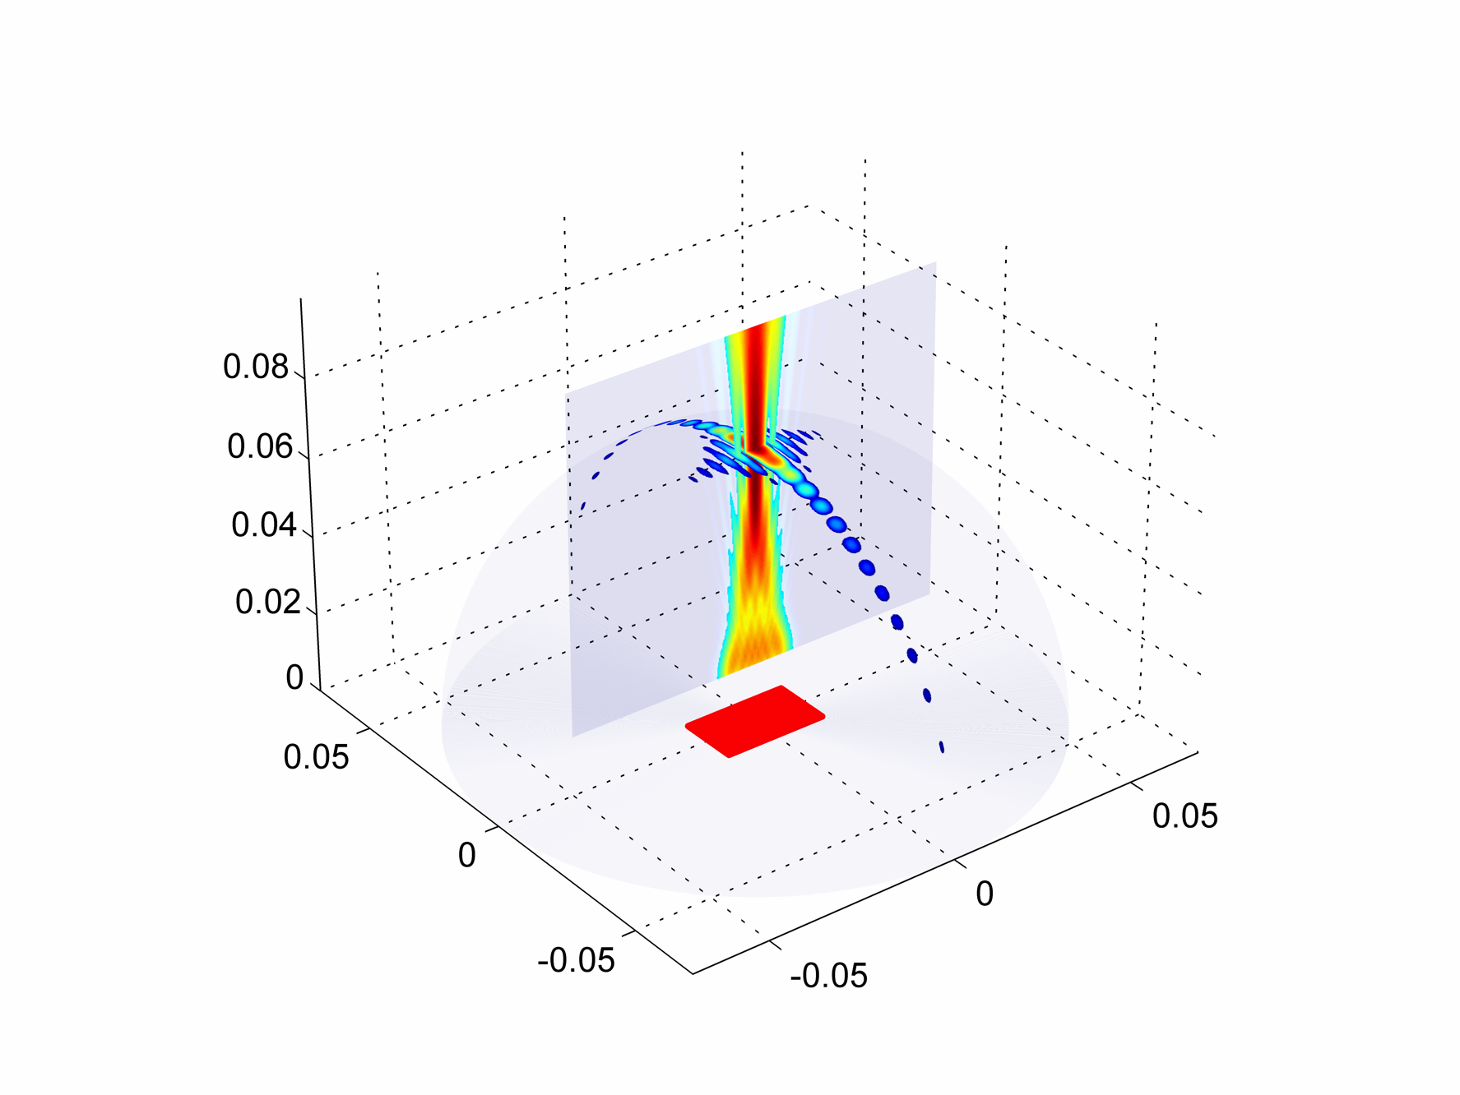
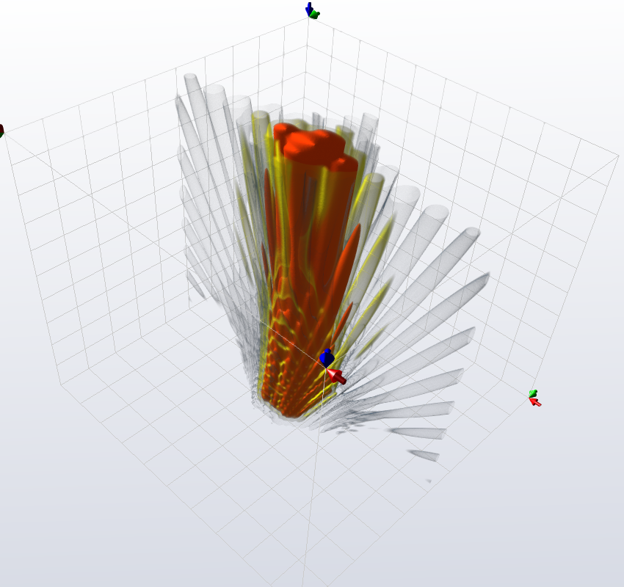
Acoustic beam simulation: Sensitivity, resolution, contrast
Notes:
This figure shows two views of an amplitude of pressure generated by a vibrating phased array probe. Such image is very quick to obtain when taking several assumptions:
Each element vibrates uniformly
The wave is radiated without reflection into the medium
The medium is isotropic liquid (solids are similar, but not exactly the same, as energy is being commited to shear waves)
We agree for a finite accuracy of numerical integration of Rayleigh integral
Etc.
At this point it is worth noting one of the basic ways of obtaining an image. We use the phased array of radiators to form the acoustic beam (it is called a beam because it looks like a beam). We know that any reflector in the way of the beam will be insonified and re-emit the acoustic energy, and at the same, any reflector NOT in the way of the beam, will not do that. Therefore by knowing where the beam goes, we can know where the reflector is. Time of flight of the energy between the probe and reflector is used to estimate the distance.
In other words, the acoustic beam behaves like a spotlight. We move the spotlight around the room. If something shines, we know that it must be in the way of the beam.

Slide 10
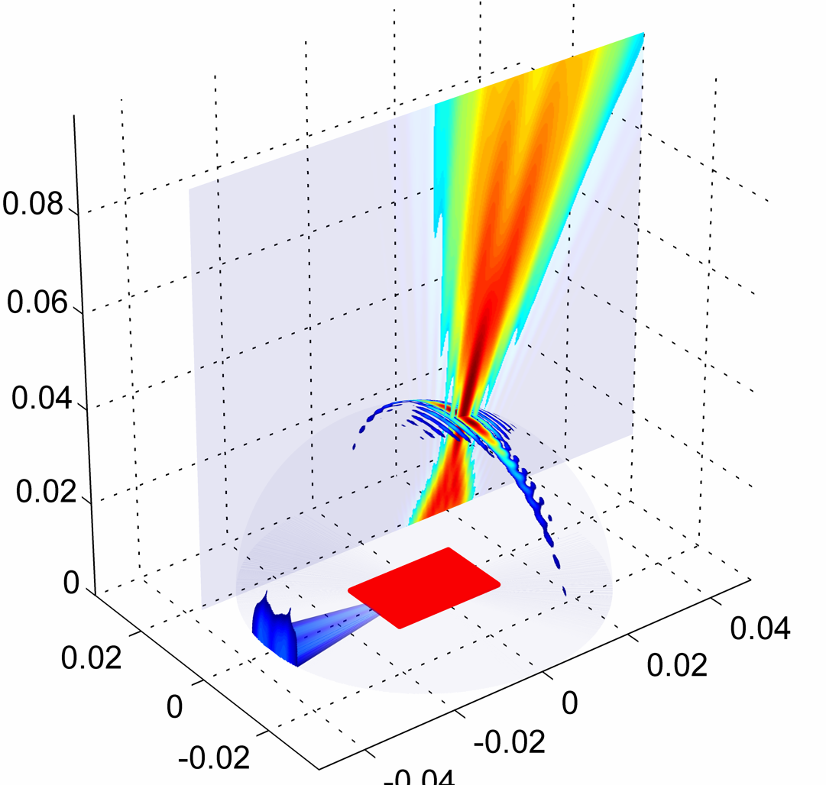
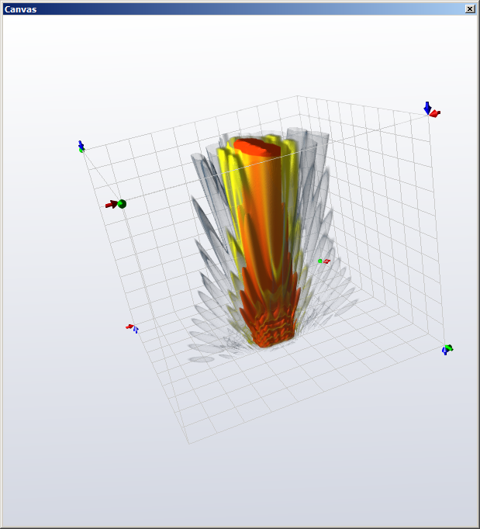
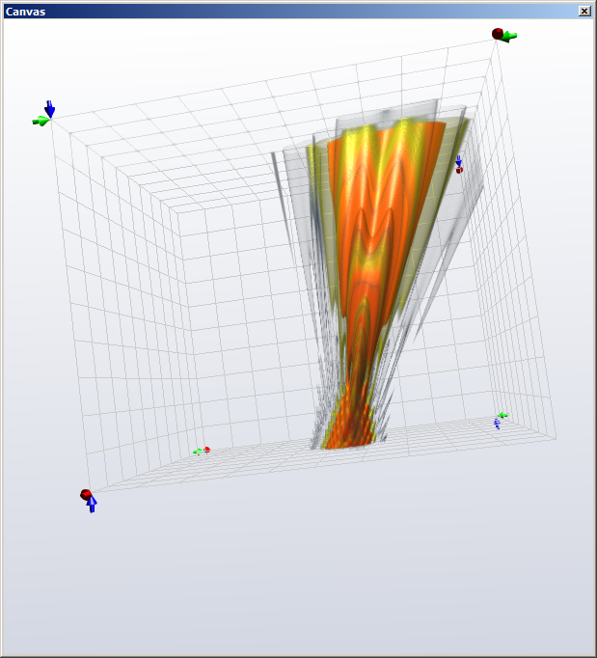
Sensitivity, resolution, contrast
Notes:
Using the probe elements, we can form the beam to go in specified direction; we can also focus it (with limitations).
Using 1D phased array probe, we can only actively steer and focus in one direction; that’s why the other axis is called the passive axis. Using 2D phased array probe, we would be able to steer and focus in all directions; however, there is many applications where this is not needed.

Slide 11
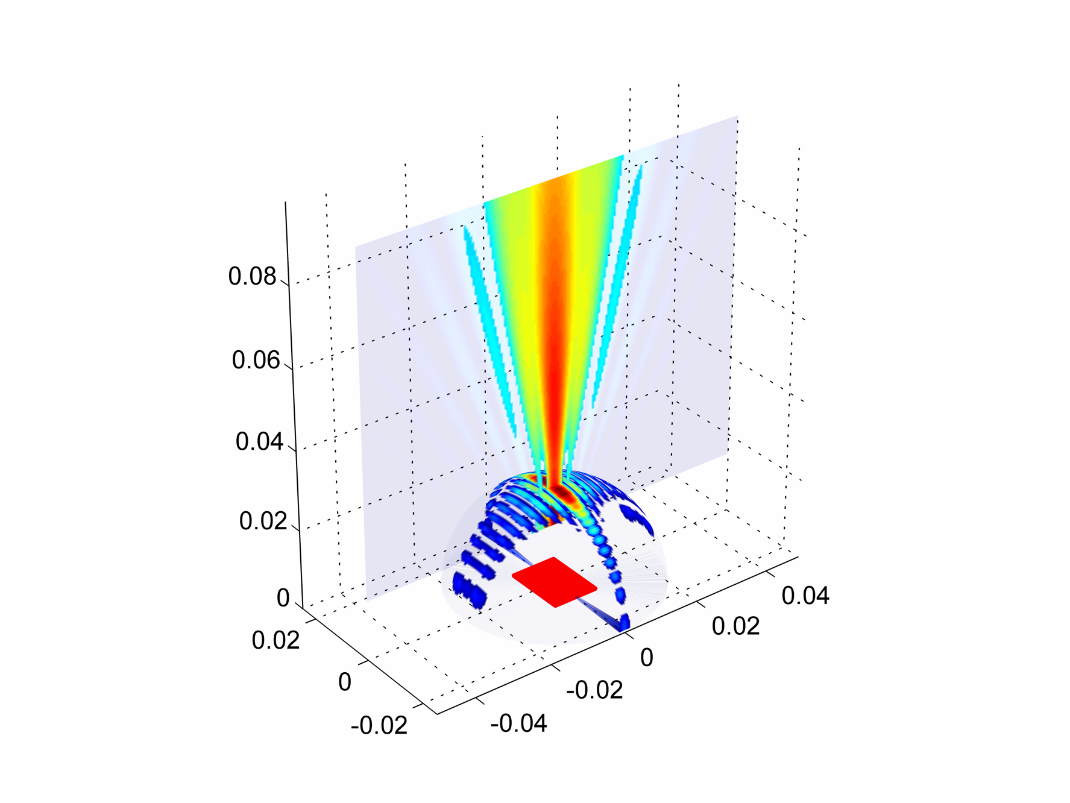
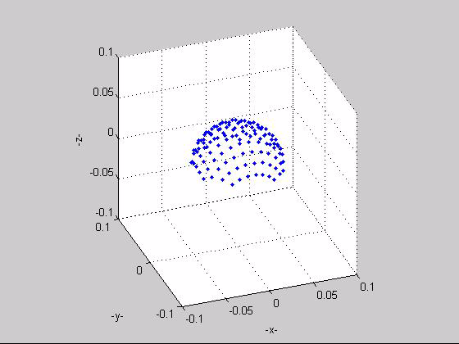
The Lambert azimuthal equiareal projection

Slide 12
Firing the probe: linear scan
Beam is electronically translated across array aperture
Alternative to mechanical scanning of a single probe
No mechanical movement of transducer
Faster inspection
Notes:
Here are several ways of how can we use the elements of the probe to form an acoustic beam . . . . .
! In each of the following examples, we can localize the defects by having an understanding of where do we send the mechanical waves to.
It is very important to understand the characteristics of the beam that is being created.

Slide 13
Firing the probe: Focussing
Beam is electronically focussed by applying symmetrical delay laws to the elements of the array
One device can focus at several depths through a sample
Faster inspection of the volume of thick samples using dynamic focussng

Slide 14
Firing the probe: Steering
Beam is electronically manipulated in the sample by applying different delay laws to individual array elements
One device can inspect a sample at different angles
Faster inspection of complex geometries
Combine with electronic scanning and electronic focussing to maximise potential inspection capability

Slide 15
Firing the probe: Full Matrix Capture
No physical beam, instead all combinations of transmit-receive signals are captured
Beamforming completed in computer using collected signals
Total Focussing Method – Virtual transmit AND receive focussing at the same time
Potentially faster than other methods if appropriate hardware is used
Notes:
One method recently gaining traction in NDE world is the Full Matrix Capture. Actual beam forming is done synthetically in computer, after collecting all the signals. This can result in getting a better image (better quality or lower cost, or both).

Slide 16
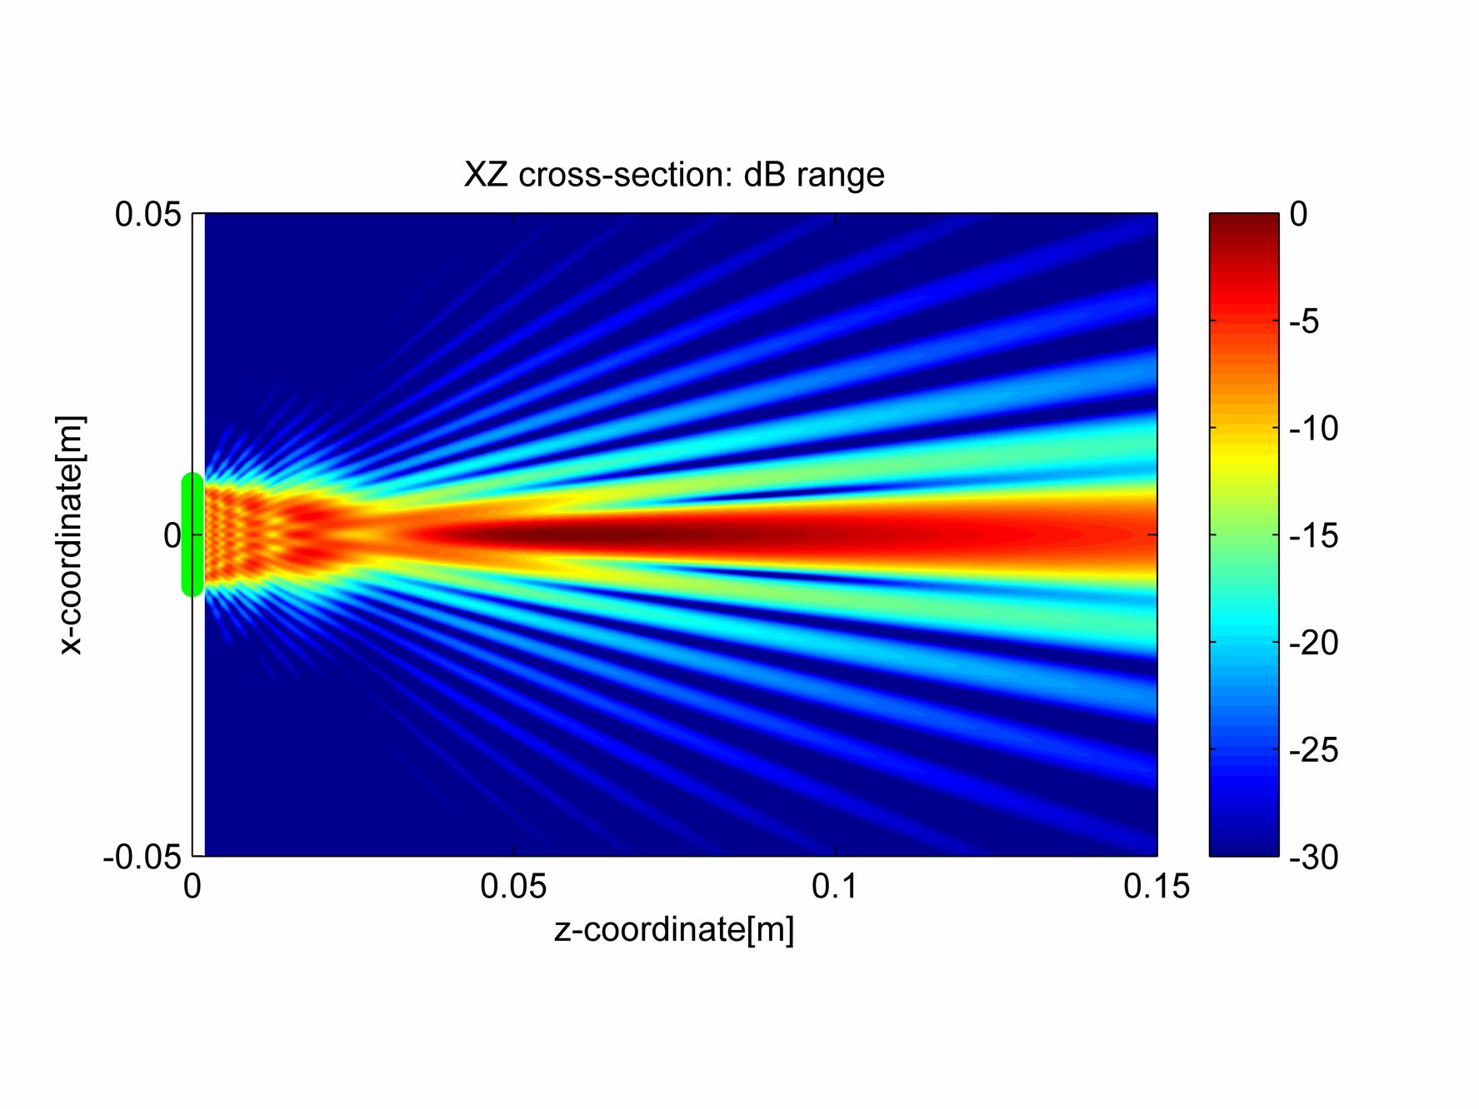
Near field vs far field
Notes:
Before we go any further, let’s discuss one specific phenomenon that we have to be aware of. The “near field” and “far field” effect.
Near field is where the waves emitted by the probe interfere and create a complex pattern. In particular, this pattern MAY result in some points NOT BEING INSONIFIED. This is very important to understand, so that you don’t miss some reflectors.
Far field, in general, is predictably and uniformly insonified, subject to beam dispersion and material properties (losiness). Losses of beam energy come primarily from friction or grain boundary reflections (small reflectors). It is interesting to know that water (and possibly other materials) is also significantly non-linear (F=k*x does not hold exactly) and energy is lost into generating harmonics.
One of the ways to create the acoustic beams and avoid the problem of the near field, is to combine focussing with variable aperture size. So for each transmission the aperture changes in order to get just the right beam that will cover the area of interest.

Slide 17
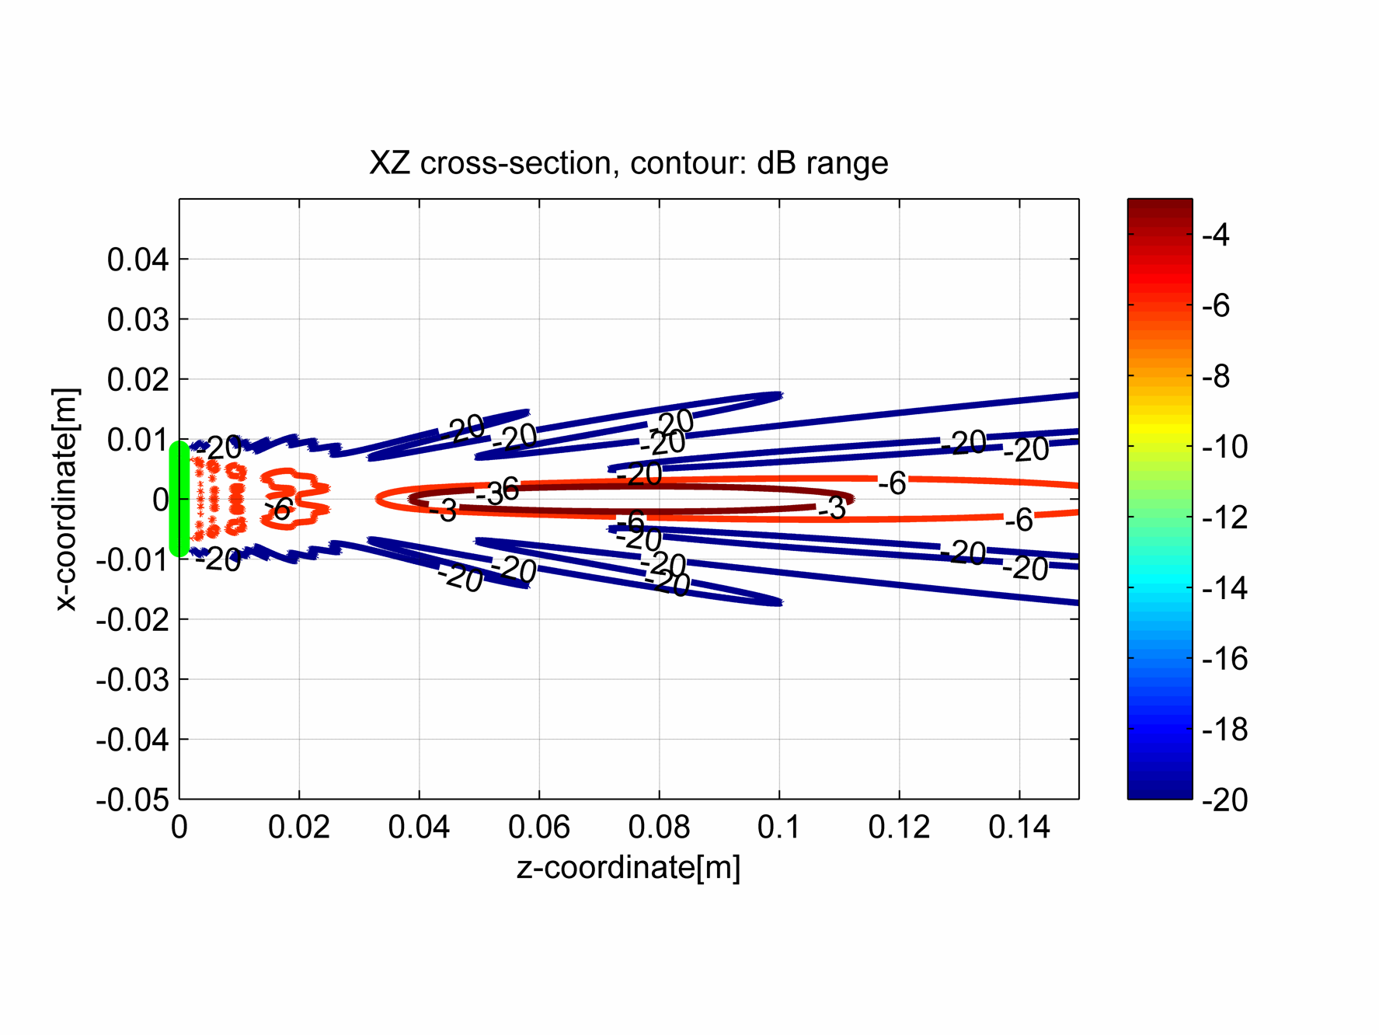
Near field vs far field
Notes:
Another view – in case if previous is not clear
Near field:
Can focus – down to 1 wavelength if all parameters set perfectly
Can steer
Might be better not to use entire aperture of the probe
Far Field:
Limited to no focus (far field beam width only)
Best to use as big aperture as possible

Slide 18
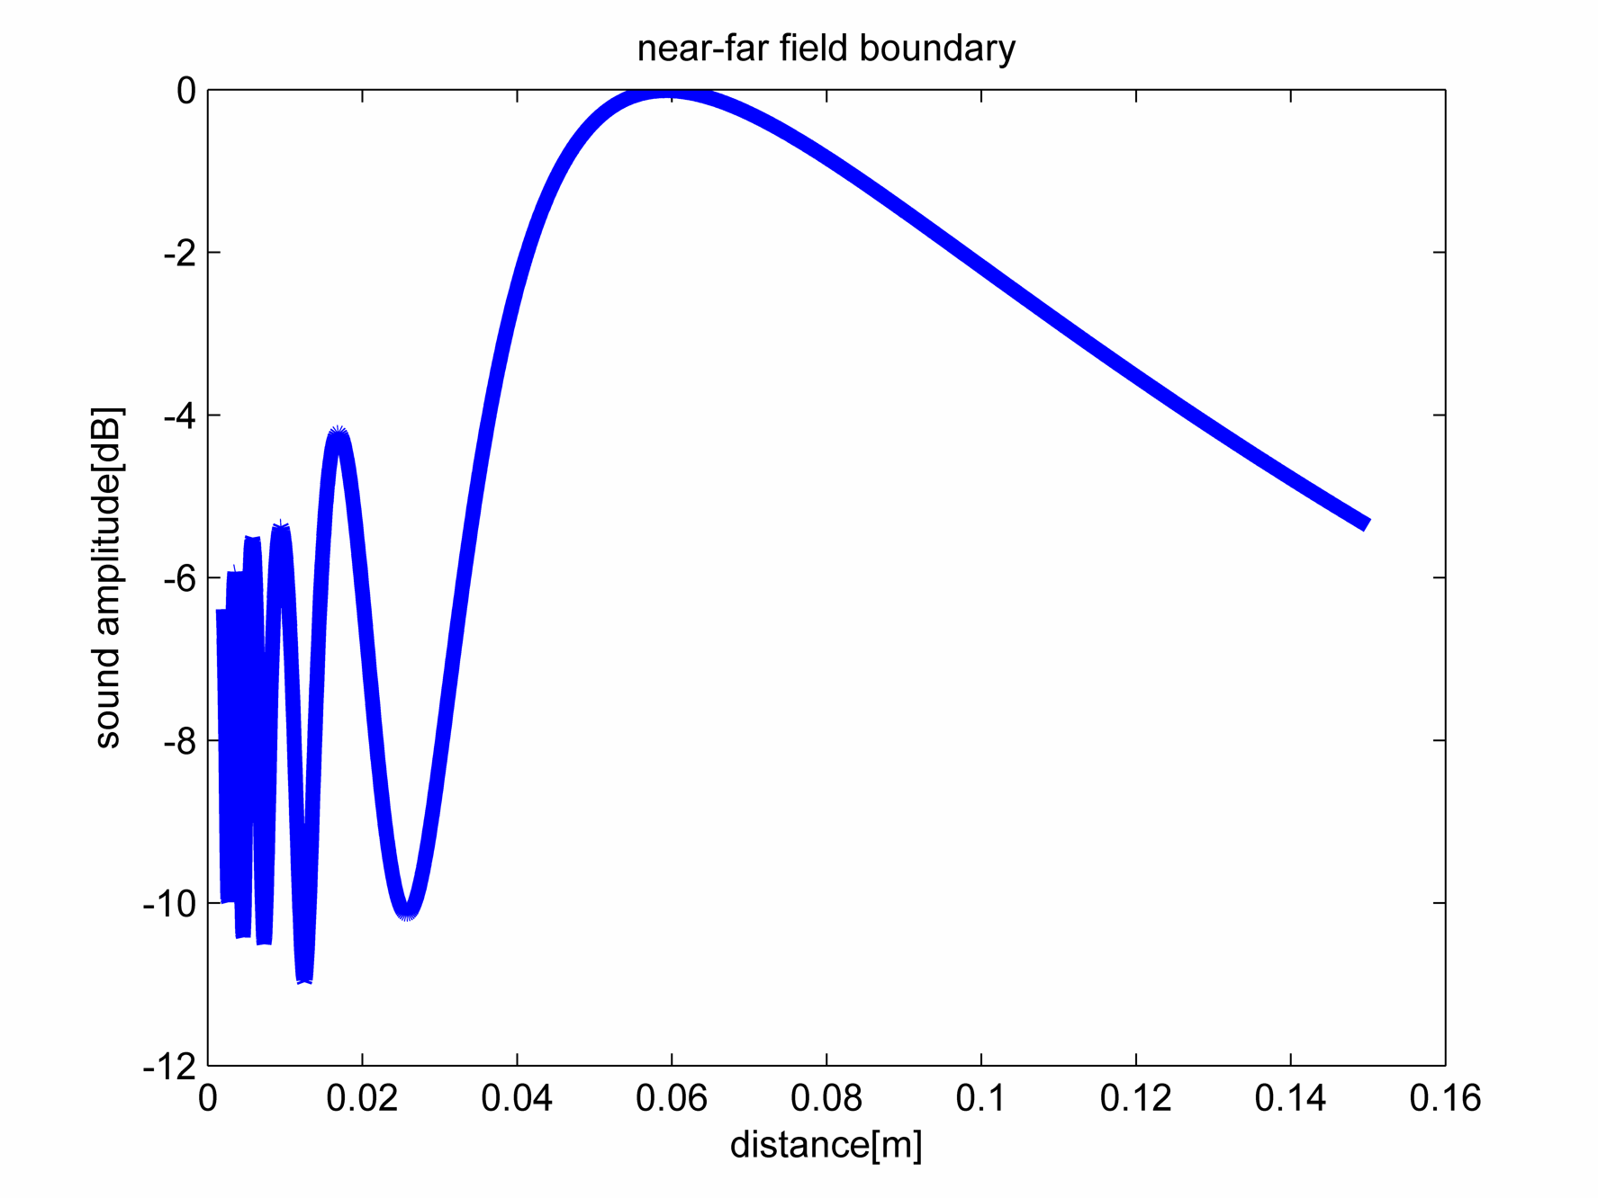
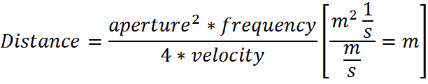
Near field vs far field
Notes:
Detailed cross-section trough the middle of the beam. Distinction between the near and far field is quite clear to see; however, the exact equation depends on the exact definition of what is the near field. Myself, i find usefull the equation that shows where the “natural focus” of the beam occurs, and for that, you need the constant factor of 4 in this approximate equation.
This particular curve has been obtained numerically using cueBeam; You can find exact solutions for this curve in the literature, or you can also solve it yourself.

Slide 19
Probe design guidelines
 | design guideline |  |  | detection | reflector characterisation |  |  | Suitability For application
 |  |  | effect on: → | detectability | sensitivity | resolution | contrast | coverage | cost
 | parameter ↓ | symbol
primary | number of elements | n | the more . . . | ↑ | ↑ | ↑ | ↑ | ↑ | ↑
 | element pitch | d | the larger . . . | ↔ | ↔ N | ↑↑ | ↓ N | ↔ | ↔
 | element width | e | the larger . . . | ↑ | ↑ | ↔ | ↓ | ↓ | ↔
 | passive aperture | W | the larger . . . | ↑ | ↑ | ↔ | ↓ | ↑ | ↔
secondary | element gap | g | the larger . . . | ↓ | ↓ N | ↔ | ↔ N | ↔ | ↓
 | active aperture | A | the larger . . . | ↑ | ↑ | ↑↑ | ↔ N | ↑ | ↔
 | note: A~=n*d; and d=e+g; therefore A should be viewed in exchange for n or d, and g in exchange for e or d
 |  | legend: | ↔ | insignificant influence |  | Assuming that remaining parameters stay the same or are adjusted up
 |  |  | ↑↑ | large positive influence
 |  |  | ↑ | typically goes up (good)
 |  |  | ↓ | typically goes down (bad)
 |  |  | N | very nonlinear relationship, detailed simulation needed
Handout
Notes:
To summarize, the process can be as follows:
Maximize number of elements while being constrained by cost;
Use simulation to optimize element pitch to suit resolution and contrast needs of the application.
Element width typically should be simply maximum possible, with exception where it limits coverage below acceptable limit. (element size affects directivity).
The passive aperture should be designed for the prevailing reflector depth – see the near/far field section.
The sensitivity should be evaluated at the end; if it is good enough, the process is finished. If it is not enough, decide on what can be sacrificed to improve it (cost, coverage, contrast?)

Slide 20
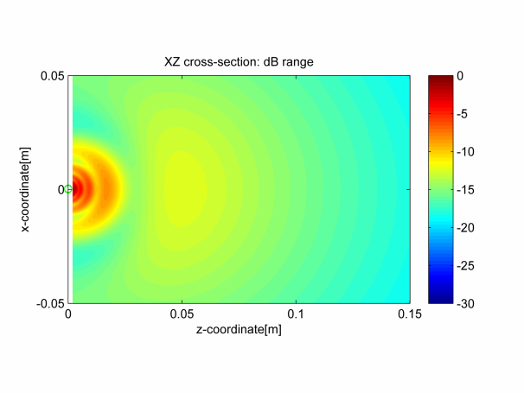
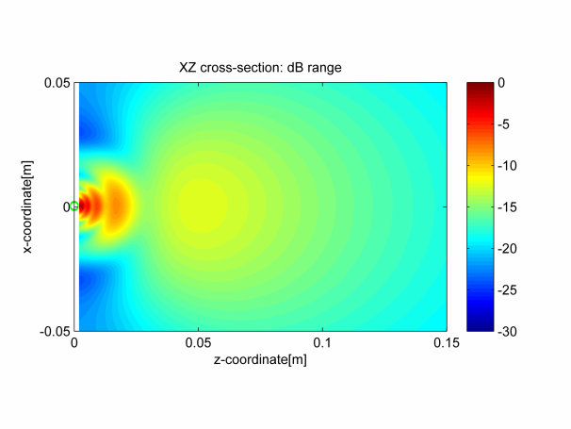
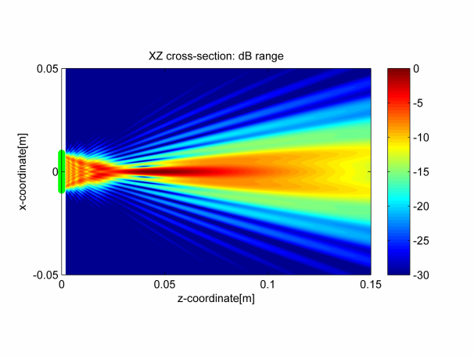
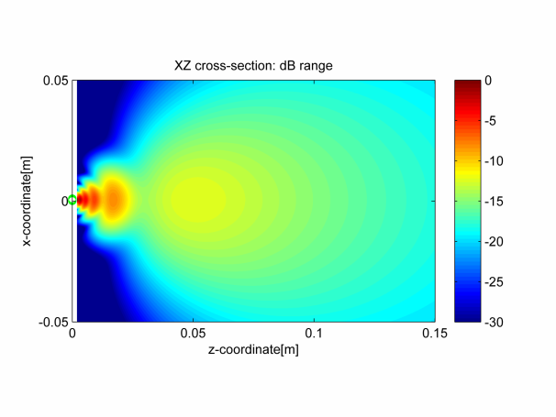
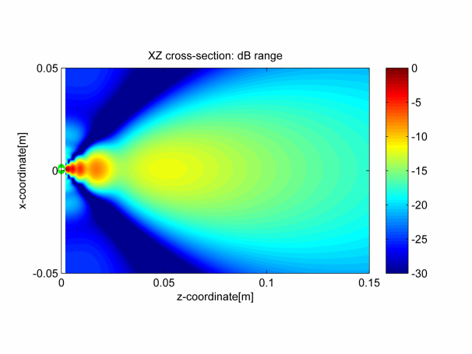
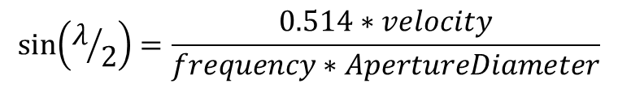
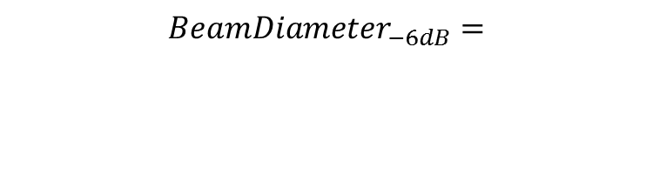
Helpful relationships
Effect of element size on -3dB beam width
Focussing
0.50λ : 170deg
0.75λ : 82deg
1.00λ:60deg
1.50λ: 40deg
$${BeamDiameter}_{−6dB}=$$ $$\frac{1.02∗ FocalLength∗velocity}{frequency∗ApertureDiameter}$$
Angular beam width
for large apertures:
$$\sin\left(λ/2\right)=\frac{0.514∗velocity}{frequency∗ApertureDiameter}$$
Notes:
Focussing: note, the equation is approximate!

Slide 21
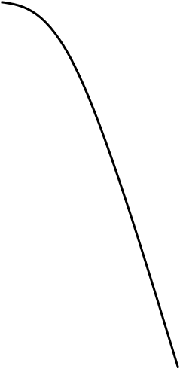
Far field directvity function
n – number of elements
k – wavenumber
d – distance between elements
H(θ) is a sinc function which is a function of aperture dimensions and wavelength
for λ >> W – wide beam characteristic
for λ << W – narrow beam characteristic, with more sidelobe activity
main lobe
sidelobes

Slide 22
Grating Lobes
The following can be observed from this directivity function
Both numerator and denominator vanish when
It is possible to have more than one major lobe.
This is clearly undesirable from an imaging point of view and the angles of these grating lobes occur when

Slide 23
Grating Lobe Example
Consider a linear array with kd=10 and N=5. Grating lobes will appear form m=1,2,3…
H(θ)
main lobe
1
grating lobe, 40º
- not possible
side lobes
90º

Slide 24
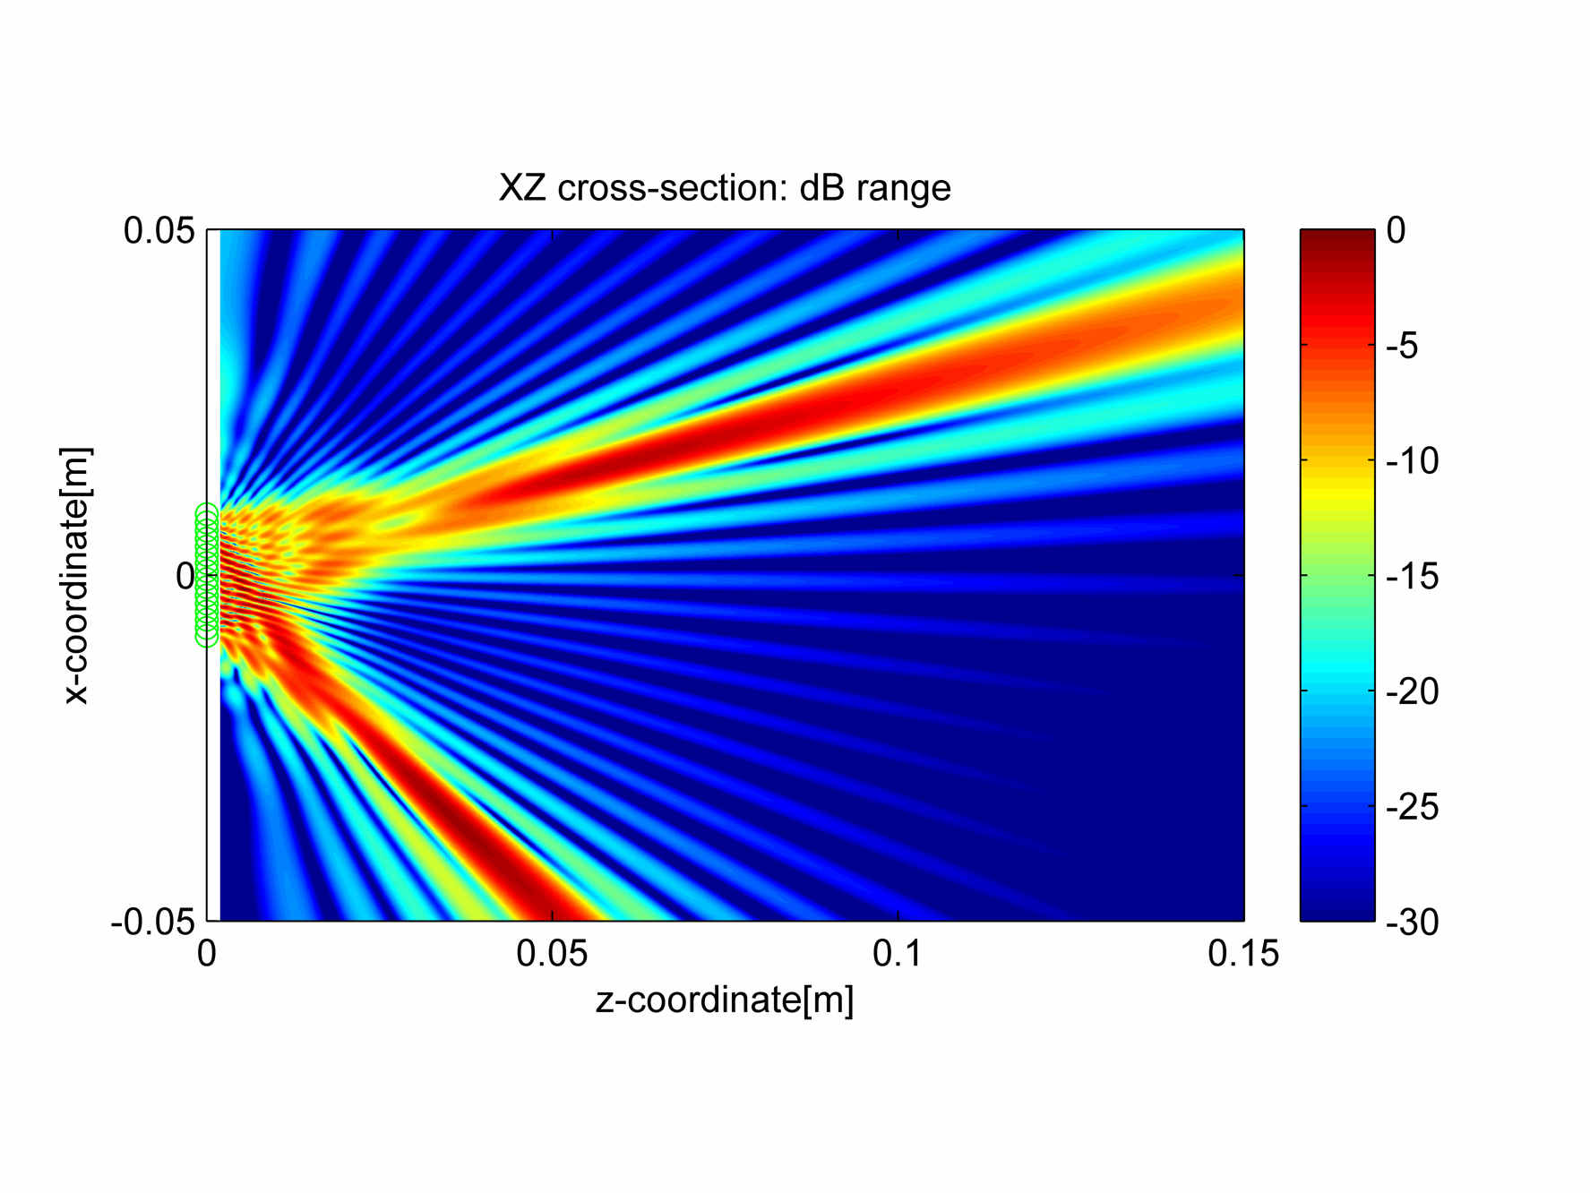
Grating Lobe Example, d=1λ
Note: Grating lobes significantly less pronounced when operating wideband NDE transducers! use time-domain simulation for conclusive results.
Notes:
Note: Grating lobes significantly less pronounced when operating wideband NDE transducers! use time-domain simulation for conclusive results.

Slide 25
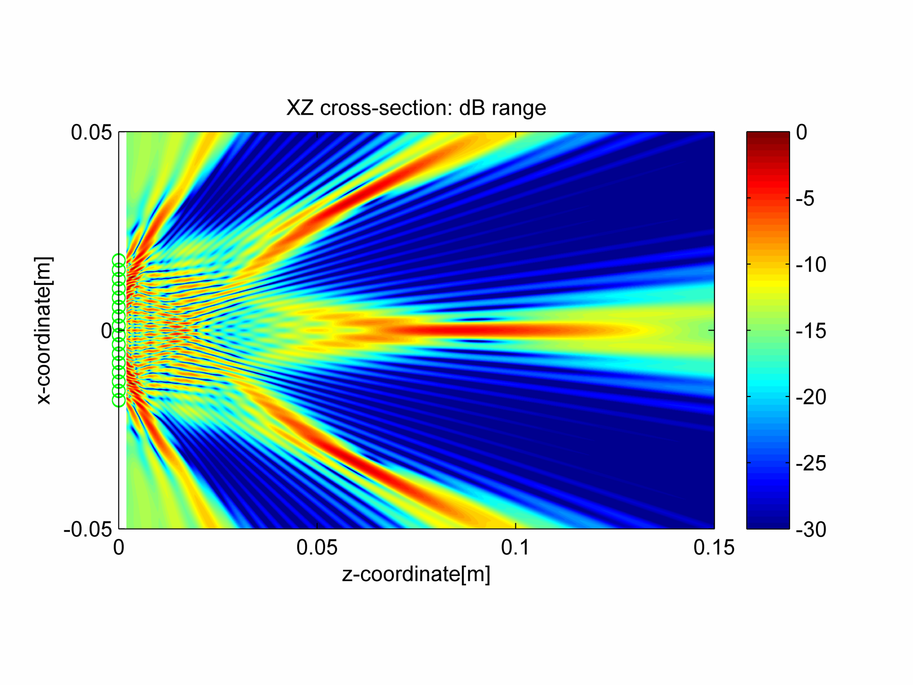
Grating Lobe Example, d=2λ

Slide 26
Array Beam Characteristics - Overview
Main lobe and side lobe characteristics are a function of array element size and pitch
In array configurations, parasitic grating lobes can be generated due to even sampling across the array elements
The angle of grating lobes can be determined from
For θ = -45º and p=λ, α_{grating} = 17º
For θ = 90º and p=λ/2, α_{grating} = -90º

Slide 27
Array Beam Characteristics – Grating Lobe Suppression
Grating lobe amplitude depends on array pitch, number of elements, operating frequency and transducer bandwidth.
Grating lobe amplitude can be reduced by:
Decreasing operational frequency
Reducing pitch size
Increasing bandwidth, which spreads out the grating lobe in the frequency domain
Introducing a wedge
Randomising the array element spacing

Slide 28
Determination of Focal Law
assign which element will have zero delay.
this will be the element with the longest path in time to the focal point
work out the time for all other elements to reach focal point
time delays are calculated with respect to zero delay path

Slide 29
Questions

Slide 30
Example design:
Pick a distance to reflector (10-200mm)
You are limited to 16 elements
Assume that the reflector can be +-30 degrees off probe axis
Maximize resolution in both active and passive planes
Try apodising to improve contrast, note effect on resolution

Slide 31
cueBeam: Usage
Open „cueBeam_linear_array_basic”
Edit „modify some of the defaults” section
Run (F5)
Look into environment, beam, probe, simulation variables
You are allowed to edit everything, but keep your original files in case of problems. Golden rule – change 1 thing per time.
when you are comfortable with the above, but not earlier,
try „cueBeam_linear_array_pitch_sweep” and „cueBeam_linear_array_angle_sweep”
This code works much faster on a 64-bit system with CUDA card installed – try it at home

